Slide 1

DEPARTMENT OF ARTIFICIAL INTELLIGENCE AND DATA SCIENCE
Artificial Neural Networks and Deep Learning: 21ADG64
LA1 - Seminar
“OVERFITTING AND UNDERFITTING IN NEURAL NETWORKS”
Presented By
Shivi Maheshwari
[1NT21AD046]
Name of the Course Instructor Dr Meenakshi

Slide 2

CONTENTS
Introduction and Motivation
Methodology and Approach
Results and Analysis
Conclusion and Future Recommendations
Demo video of code
Github link of PPT and Code
References

Slide 3
INTRODUCTION AND MOTIVATION
Motivation
Imagine you're training a neural network to recognize handwritten digits. You have a dataset consisting of thousands of labeled images of digits ranging from 0 to 9. Your goal is to train the neural network to accurately classify new, unseen digits.
The Challenge of Overfitting
Overfitting occurs when a model learns to capture noise or random fluctuations in the training data, instead of learning the underlying patterns. In the context of our digit recognition example, an overfitted model might memorize specific details of the training images that are not relevant to distinguishing between different digits.
The Challenge of Underfitting
On the other hand, underfitting occurs when a model is too simple to capture the underlying structure of the data. In our digit recognition example, an underfitted model might fail to capture important features that distinguish between different digits.

Slide 4
INTRODUCTION AND MOTIVATION
Overfitting and underfitting are common challenges faced while training neural networks.
Overfitting and underfitting can have significant implications for the performance of neural networks in real-world applications.
In the case of overfitting, the model may fail to generalize to new, unseen data, leading to poor performance in deployment.
In the case of underfitting, the model may fail to capture important patterns in the data, also resulting in poor performance.

Slide 5
METHODOLOGY AND APPROACH
Data Generation: We generate sample data with a quadratic relationship and introduce some noise to simulate real-world scenarios. This dataset serves as a simple example for regression analysis.
Data Splitting: The data is split into training and testing sets using train_test_split from sklearn.model_selection. This splitting ensures that we have separate datasets for training and evaluating our models.
Model Construction:
a. Underfitting (Linear Regression): We fit a linear regression model to the training data. Linear regression is a simple model that may not capture the underlying complexity of the data well, leading to underfitting.

Slide 6
METHODOLOGY AND APPROACH
b. Overfitting (Polynomial Regression): We fit a polynomial regression model to the training data. Polynomial regression is a more complex model that can capture intricate relationships between features. However, with a high degree polynomial, it may fit the training data too closely, leading to overfitting.
Model Evaluation: We evaluate the performance of both models using Mean Squared Error (MSE) calculated on the testing data. MSE quantifies the average squared difference between the actual and predicted values. Lower MSE indicates better model performance.
Visualization: We visualize the fit of both models on both training and testing data. This allows us to visually inspect how well the models capture the underlying patterns in the data.

Slide 7
RESULT AND ANALYSIS
Model Fits:
Underfitting (Linear Regression): The linear regression model produces a simple, straight-line fit to the data. It fails to capture the quadratic relationship between the features and the target variable adequately.
Overfitting (Polynomial Regression): The polynomial regression model produces a more complex fit to the data. With a degree of 10, the polynomial model fits the training data very closely, capturing even the noise in the data. However, it may be too flexible and fit the noise rather than the underlying pattern, leading to overfitting.
Mean Squared Error (MSE):
Underfitting (Linear Regression): The MSE for the linear regression model on the testing data is relatively high, indicating poor performance in capturing the underlying pattern.
Overfitting (Polynomial Regression): The MSE for the polynomial regression model on the testing data is likely to be lower than that of the linear regression model, suggesting better performance on the training data. However, it may not generalize well to unseen data due to overfitting.

Slide 8
CONCLUSION AND FUTURE RECOMMENDATION
The scatter plots of the training and testing data, along with the fitted curves for both models, allow us to visually inspect the performance of each model. We can observe how well each model captures the underlying relationship between the features and the target variable.
The results highlight the trade-off between model complexity and generalization performance.
These findings emphasize the importance of selecting an appropriate model complexity that balances the bias-variance trade-off to achieve optimal performance on both training and testing data.

Slide 9
CONCLUSION AND FUTURE RECOMMENDATION
Regularization Techniques: Implement regularization techniques such as L1 and L2 regularization to mitigate overfitting in polynomial regression models.
Cross-Validation: Cross-validation provides a better estimate of a model's ability to generalize to new data by splitting the dataset into multiple training and testing subsets.
Feature Engineering: Feature engineering can help improve model performance and reduce the risk of overfitting by providing more relevant information to the model.
Model Selection: Experiment with different model architectures and hyperparameters to find the optimal balance between bias and variance.

Slide 10
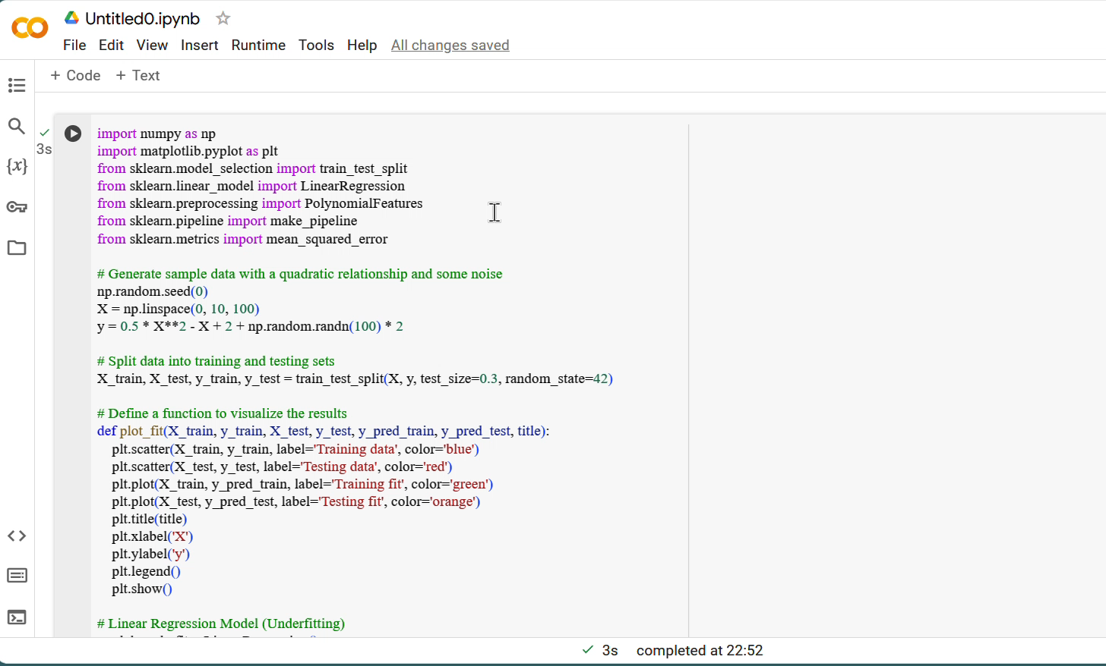
DEMO VIDEO OF COD E

Slide 11
Github link of PPT and Code
https://github.com/2003Shivi/Underfitting-and-Overfitting-.git

Slide 12
REFERENCES
Haykin, S. (1994). Neural networks: a comprehensive foundation. Prentice Hall.
Documentation and Guides like Scikit-learn and TensorFlow and Keras Documentation.
Jason Brownlee, "Understanding Overfitting in Machine Learning," Machine Learning Mastery. [Online]
Christopher M. Bishop, Pattern Recognition and Machine Learning.
Online Tutorials and Blogs like Towards Data Science,Medium.

